Slide 1
Faculty Senate Meeting
February 22, 2024

Slide 2
Meeting procedure
Only Senators may debate motions
Only Senators can vote
If you are not a Senator, or a proxy, you cannot vote or debate
Do not speak over someone, or out of order
  Raise your hand (For those online please use “Raise Hand” on the Zoom app)
  The President will call on you and then you will have the floor
  Please wait for the microphone
Unless you have been recognized (told you have the floor), you may not speak

Slide 3
Meeting Minutes
Robert's Rules of Order say that meeting minutes are simply a summary of what happened at the meeting.
They are not a play by play of everything that happened or what members said.
We will be using Robert's Rules to guide our recording of minutes.
If needed, Faculty Senators may request access to the audio recording of the meeting. Please email facsenate@mst.edu with justification.

Slide 4
I. Call to Order and Roll Call
P. Runnion, Secretary
February 22, 2024

Slide 5
II. Approval of Minutes
KC Dolan, President
January 25, 2024

Slide 6
III. President’s Report
      KC Dolan

Slide 7
NO IFC meeting in February
Board of Curators met February 8
Approved extension of test-optional for another year
Next meeting March 4 in Columbia

Slide 8
Campus Matters
Library use survey
  Next week
  Multiple-choice, under 15 minutes
  Interested in use of library
FS climate survey
  In process, to be distributed in April
Committee elections
  Elections in April
  Need NOMINEES now
  Check in with your chairs
  Shared Governance

Slide 9
Campus Matters
FAFSA delayed—
  Not impacting current year
  Might come up in advising
  Keep an eye out
  Contact Student Financial Assistance office with questions (sfa@mst.edu)
Faculty Lounge (The Gathering Place)
  Plans underway
  Contact Dave W if you’re interested in participating
Strategic Plan
  Taskforces underway
  Look out for upcoming open forums

Slide 10
IV. Campus Reports
      Staff Council
      K. Walkup

Slide 11
Upcoming Events
S&T’s Faculty and Staff Appreciation Night – tonight @ 7:30pm
Thank-you grams – closes February 23rd
Next Staff Council meeting – March 14th
Staff Appreciation Day – May 30th

Slide 12
IV. Campus Reports
      Student Council
      (No Report)
Notes:
Jordan Ropp

Slide 13
IV. Campus Reports
      Grad Student Council
      (No Report)

Slide 14
V. Special Topic
      IFC Shared Governance Task Force
      M. Bruening

Slide 15
History
IFC (Intercampus Faculty Cabinet) retreat in 2021 cited shared governance as a common concern
Task force with 1 rep from each campus
Group looked at AAUP’s Statement on Government of Colleges and Universities, AAU’s Academic Principles, CRRs, campus practices
March-May 2022, survey of faculty, using AAUP’s Shared governance assessment tool, plus a few internal questions
Final report endorsed by IFC, January 22, 2024

Slide 16
Survey results
First polled faculty leaders
  Current and recent senate officers, 22 UM, 5 (50%) at S&T responded
Then polled all System faculty
  460 UM faculty, 75 (about 25%)* at S&T responded
  At S&T, 69% t/t-t, 21% NTT (10% did not indicate)
  *corrected from an earlier report of about 100

Slide 17
Some key results
On our unique questions:
86% extremely or somewhat dissatisfied with shared governance at university (4% somewhat or extremely satisfied). Very close for UM System
67% extremely or somewhat dissatisfied at college level
77% say shared governance has gotten worse (0 say it’s gotten better)

Slide 18
Some Key Results
From AAUP survey
Survey asked for each issue whether it was faculty dominance, faculty primacy, joint authority, administrative primacy, or administrative dominance
On several issues UM System is far out of line with national averages on issues of faculty primacy or dominance:
  Institutional curriculum decisions: AAUP 60%. UM 21% S&T 21%
  T-t faculty searches: AAUP 62%. UM 39% S&T 33%
  Teaching assignments: AAUP 64%. UM 40% S&T 48%
  Dept chair selection: AAUP 38%. UM 16% S&T 13%
  Strategic planning (joint authority): AAUP 21%, UM 8% S&T 7%

Slide 19
Survey comments
Key themes
  Most cited, by far: Excessive administrative dominance, top-down decision-making
  Curators and System President
  Budget
  Salary
  Hiring
  Tenure

Slide 20
Report recommendations
Restore faculty primacy/dominance to traditional areas: Curriculum, instruction, research, faculty status, degree requirements, appointments, promotions, tenure, and dismissal
Administration should avoid “information dumps.” Use senate, gen. fac. appearances to solicit feedback instead
Provide clear rationale that addresses faculty concerns when overturning faculty decisions/feedback
Share information early and often
Make collaborative use of committees

Slide 21
Since the Report: S&T’s Strategic Plan
Presented our report’s findings to the S&T Leadership Team on January 30
Dovetails with COACHE survey
More active faculty role in the Strategic Plan (due to Curators in April)
  Open forums on Feb. 6 and 7
  Faculty/staff survey on the Strategic Plan
  Establishment of faculty task forces on Academic Affairs, Student Success, and Employer-Faculty Relations
  COACHE team mapping Strategic Focus Areas to faculty leadership positions

Slide 22
Since the Report: Raise Pool Distribution
Request for faculty recommendation on faculty raise pool distribution
  AAUP Statement on Governance: “The faculty should actively participate in the determination of policies and procedures governing salary increases.”
  CRR 300.030.D.6.n: Personnel Committee: “This committee recommends to the Faculty Senate … reporting schemes and procedures regarding the annual salary and wage raise pool.”
  Process:
    DCC asked for recommendation (done)
    DCC sends recommendation to Personnel Committee (March)
    Personnel Committee seeks endorsement from Faculty Senate (April)
    Senate-endorsed procedure is sent to Chancellor and Provost

Slide 23
Suggestions for improved shared governance at S&T
Empower faculty to participate in the formation of next year’s budget (follow UMSL’s process of open forums and Budgetary Affair Committee endorsement)
Hiring: Empower faculty search committees to rank the successful faculty candidates and chairs, barring other vital considerations that are explained clearly
Your ideas??

Slide 24
VI. Reports of Standing Committees
      Campus Curriculum
      P. DeWitt

Slide 25
CCC Meeting - 23 January 2024
Total Committee Activity
  14 Course Change Requests (CC Forms)
  5 Program Change Forms (PC Forms)
  6 Experimental Course Request (EC Form)

Slide 26
CCC Meeting - 23 January 2024
Course Changes (CC) Requested
File: 5035 ALP 4001 : Special Topics
File: 5036 ALP 5001 : Special Topics
File: 5037 ART 5001 : Special Topics
File: 2393.4 CHEM ENG 5242 : Intermediate Chemical Process Safety
File: 510.1 ELEC ENG 2100 : Circuits I
File: 856.5 ELEC ENG 2120 : Circuits II
File: 531.1 ELEC ENG 3600 : Electromagnetics
File: 572.1 ELEC ENG 6560 : Power System Protection
File: 5029 FRENCH 1001 : Special Topics
File: 5030 GERMAN 1001 : Special Topics
File: 5031 PHILOS 1001 : Special Topics
File: 5032 RUSSIAN 1001 : Special Topics
File: 5033 SPANISH 1001 : Special Topics
File: 5034 THEATRE 1001 : Special Topics

Slide 27
CCC Meeting - 23 January 2024
Program Changes (PC) Requested
File: 58.25 FINANCE-MI : Finance Minor
File: 157.46 HIST-BA : History BA
File: 74.12 IST-MI : Information Sci & Tech Minor
File: 81.21 MARKET-MI : Marketing Minor
File: 93.14 MIL SC-MI : Adaptive Leadership Minor

Slide 28
CCC Meeting - 23 January 2024
For Informational Purposes; No Senate Approval Required
Experimental Course (EC) Requested
File: 5013 ART 1001.003 : Intro to Glassmaking
File: 5014 ART 3001.005 : Advanced Glassmaking
File: 5009 COMP ENG 5001.006 : Machine Learning and Deep Learning for Big Data Processing
File: 5028 ELEC ENG 6001.008 : RF Desensitization in RF/Digital Systems
File: 5007 MUSIC 1001.001 : Intro to Music Entrepreneurship
File: 5027 SPANISH 4001.002 : Latin American Civilization and Culture

Slide 29
CCC Meeting - 23 January 2024
Curriculum committee moves for FS to approve the 14 CC and 5 PC form actions.
Discussion: Questions or comments?

Slide 30
CCC Meeting - 23 January 2024
Report: Approval path for NEW degree programs
Motion to approve General Education approval process

Slide 31
VI. Reports of Standing Committees
      Budgetary Affairs
      M. Fitch

Slide 32
Topics/Referrals
  Personnel and budget in division level offices and higher over the years
  FY 24 Budget = small changes
  FY 25 budget = ideas
  Advancing STEM funding second tranche
  Next time
  Five-year budget
  Maintenance costs?

Slide 33
FY2024 - Operating Revenues
Operating Funds (in millions)
As budgeted, because
Operating Revenues | FY2022 | FY2023 | FY2024
Tuition and Fees | 119.3 | 125.3 | 130.7
Less Scholarship Allowances | 38.7 | 43.6 | 45.5
Net Tuition and Fees | 80.6 | 81.7 | 85.2
Institutional Discount Rate | 32.4% | 34.8% | 34.8%
Auxiliary Enterprises | 1.2 | 1.4 | 1.1
Other Operating Revenues | 10.5 | 12.5 | 10.7
State Appropriations | 53.0 | 55.9 | 60.1
Private Gifts | 0.4 | 0.5 | 0.1
Spendable Investment Income | 3.4 | 3.6 | 3.7
Total Operating Revenues | 149.0 | 155.5 | 161.0
Nonresident enrollment up
Internal discount up as $, similar %
Student Affairs (dorms + food), mostly
Mostly research indirect
State up a bit
(KF money isn’t operating $)
+5.5 million, 3.5%

Slide 34
FY24 – Revenue update
First Time College
Transfers
Continuing
Res: ~$10K each
Non: ~$17K each
5,808,800
-1,932,800
Distance revenue down 1.9 M
$77,494,926
-766,626
0

Slide 35
FY2024 - Operating Revenue update
Operating Funds (in millions)
As budgeted, but now
Operating Revenues | FY2022 | FY2023 | FY2024 | FY2024
Tuition and Fees | 119.3 | 125.3 | 130.7 | 128.8
Less Scholarship Allowances | 38.7 | 43.6 | 45.5 | 44.3(?)
Net Tuition and Fees | 80.6 | 81.7 | 85.2 | 84.5
Institutional Discount Rate | 32.4% | 34.8% | 34.8% | 34.4%
Auxiliary Enterprises | 1.2 | 1.4 | 1.1 | 1.1
Other Operating Revenues | 10.5 | 12.5 | 10.7 | 10.7
State Appropriations | 53.0 | 55.9 | 60.1 | 60.1
Private Gifts | 0.4 | 0.5 | 0.1 | 0.1
Spendable Investment Income | 3.4 | 3.6 | 3.7 | 3.7
Total Operating Revenues | 149.0 | 155.5 | 161.0 | 160.3
Impact = Enrollment contingency: $1 M - 0.766 = $233,374

Slide 36
FY2024 - Operating Expenses
Operating Funds (in millions)
Operating Expenses | FY2022 | FY2023 | FY2024
Compensation
Salaries and Wages | 73.0 | 77.8 | 82.7
Benefits | 23.5 | 24.8 | 29.3
Total Compensation | 96.5 | 102.7 | 111.9
Supplies, Services and Other Operating Expenses | 29.1 | 24.8 | 29.3
Total Operating Expenses | 125.6 | 155.5 | 161.0
Net Operating Income | 23.4 | 21.0 | 17.5
Capital Expense | 6.4 | 8.9 | 10.1
6.2% increase
17.8% increase
9.0% increase
Student Affairs (dorms + food), mostly
All funds aim for 2% margin;
Operating funds going to capital expenses:
Geothermal plant

Slide 37
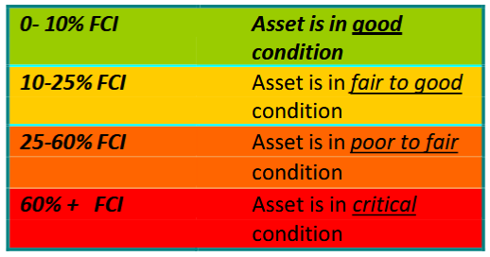
Advancing STEM = state funding
All approved by BOC + funded by state very likely
  FCNI, Facility Condition Needs Index = cost to renovate/value of building
Some Website I Googled:
We aim for 0.2, at 0.3 start planning renovation

Slide 38
FY25 – Revenue assumptions
Governor recommendations
  Core increase of 3.0% ($1.84M)
  Plus 2nd half of a total $50M in one-time capital funds for the Advancing STEM capital project (Schrenk East Renovation, Geothermal Expansion, and ERL)
Enrollment assumptions
  FTC: +89 to 1,284
  Undergraduate students: +142 to 5,464
  Graduate students: +52 to 1,184
Tuition increase likely in-line with inflation: 3.0-3.4%
  Tuition rates will be approved at a special Board meeting in May

Slide 39
FY2024 - Operating Revenue update
Operating Funds (in millions)
Now
Assume
Operating Revenues | FY2022 | FY2023 | FY2024 | FY2025
Tuition and Fees | 119.3 | 125.3 | 128.8 | 134.4
Less Scholarship Allowances | 38.7 | 43.6 | 44.3(?) | 45.7(?)
Net Tuition and Fees | 80.6 | 81.7 | 84.5 | 88.7
Institutional Discount Rate | 32.4% | 34.8% | 34.4% | 34.0%?
Auxiliary Enterprises | 1.2 | 1.4 | 1.1 | 1.1
Other Operating Revenues | 10.5 | 12.5 | 10.7 | 10.7
State Appropriations | 53.0 | 55.9 | 60.1 | 61.9
Private Gifts | 0.4 | 0.5 | 0.1 | 0.1
Spendable Investment Income | 3.4 | 3.6 | 3.7 | 3.7
Total Operating Revenues | 149.0 | 155.5 | 160.3 | 166.2
FTC + 89; UG +142, Grad +52
Tuition at inflation +3%
Internal discount down
Governor says +3%
+5.9 million, 3.7%
Impact = 51 faculty searches now = +26 = $2.9 M; ~3% merit raise = $2.5 M;
Market/equity for high turnover/low fill; Staff pay grade shift 3%; Maintenance & repair

Slide 40
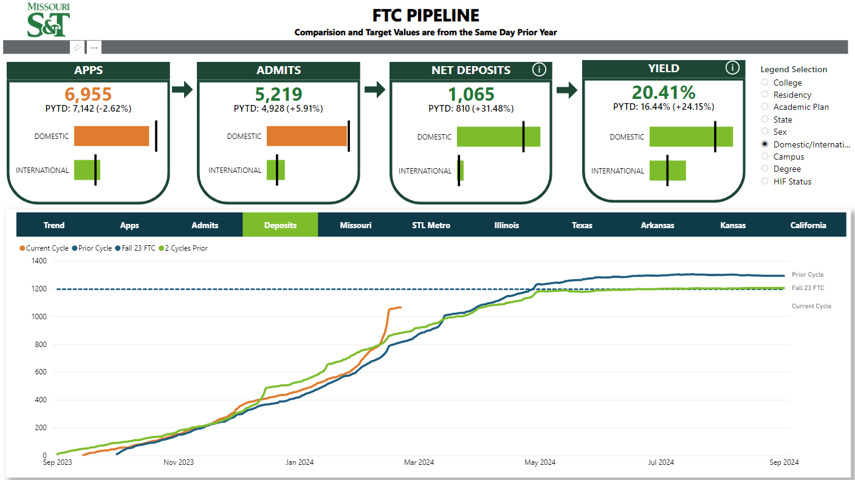
FY2024 - Operating Revenue update
Operating Funds (in millions)
Now
Assume
Operating Revenues | FY2022 | FY2023 | FY2024 | FY2025
Tuition and Fees | 119.3 | 125.3 | 128.8 | 134.4
Less Scholarship Allowances | 38.7 | 43.6 | 44.3(?) | 45.7(?)
Net Tuition and Fees | 80.6 | 81.7 | 84.5 | 88.7
Institutional Discount Rate | 32.4% | 34.8% | 34.4% | 34.0%?
Auxiliary Enterprises | 1.2 | 1.4 | 1.1 | 1.1
Other Operating Revenues | 10.5 | 12.5 | 10.7 | 10.7
State Appropriations | 53.0 | 55.9 | 60.1 | 61.9
Private Gifts | 0.4 | 0.5 | 0.1 | 0.1
Spendable Investment Income | 3.4 | 3.6 | 3.7 | 3.7
Total Operating Revenues | 149.0 | 155.5 | 160.3 | 166.2
FTC + 89; UG +142, Grad +52
Tuition at inflation +3%
Internal discount down
Governor says +3%
+5.9 million, 3.7%
Impact = 51 faculty searches now = +26 = $2.9 M; ~3% merit raise = $2.5 M;
Market/equity for high turnover/low fill; Staff pay grade shift 3%; Maintenance & repair

Slide 41
VI. Reports of Standing Committees
      Committee for Effective Teaching
      D. Burns

Slide 42
SET Data Access Policy
  Department chairs and above (administration) already have access to Student Evaluation of Teaching (SET) survey data (both numeric and open response)
  Some departments on campus have requested that specific additional personnel be granted access to this data for job task relevant reasons
  Rather than having a one-size-fits-all solution, the CET voted (12-1-2) to allow departments to set their own policies, as approved by their faculty
  We opted for a conservative 2/3 majority requirement to protect faculty who may feel threatened

Slide 43
SET Data Access Policy
Motion
  If a department wants to grant access to Student Evaluation of Teaching (SET) data to someone other than the department chair and administration (e.g. an assistant chair), their department faculty needs to approve such access with a 2/3 super-majority vote. They should have separate votes for access to quantitative data versus student comments. Such access will continue to be granted to whomever is in that position unless the department has another vote that does not have 2/3 support for continuing to provide them access.

Slide 44
VI. Reports of Standing Committees
      ITCC
      P. Koob

Slide 45
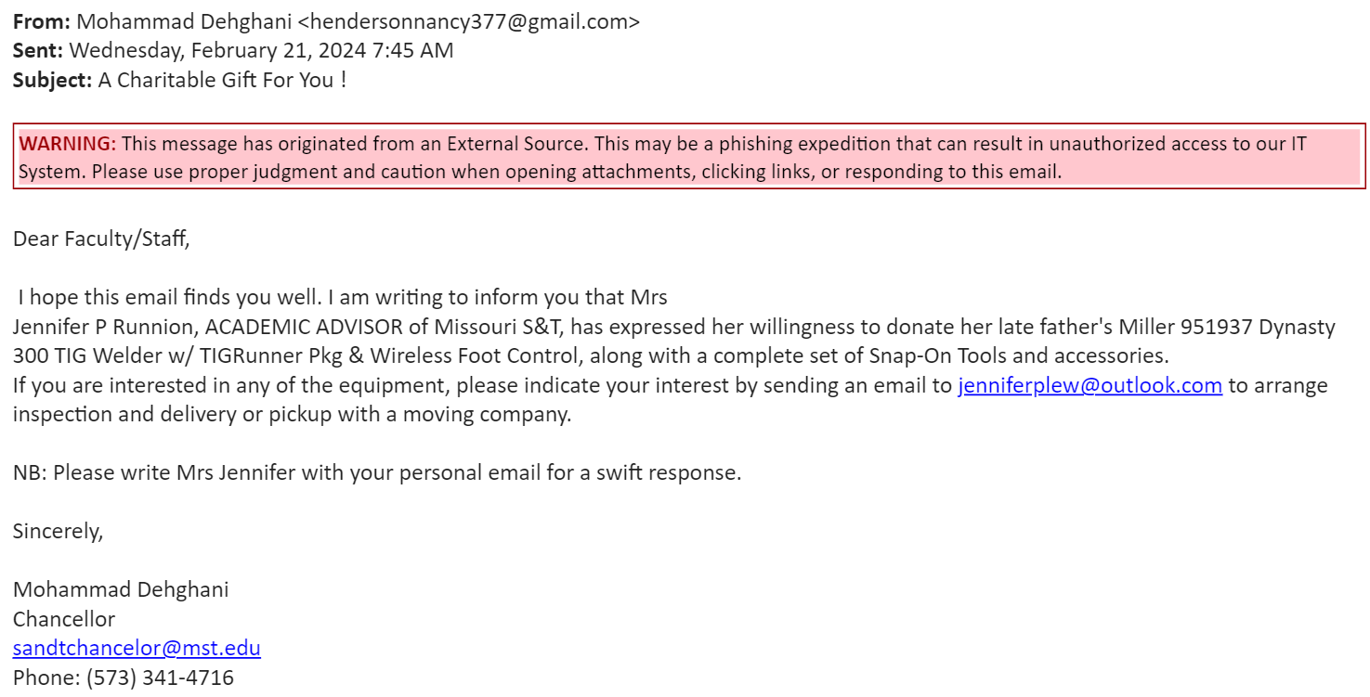
Cybersecurity Awareness 2
Phishing
  Confidence​
  Time pressure​
  Isolation​

Slide 46
Cybersecurity Awareness 2
Phishing
  Social Engineering your confidence.
  Not an S&T email
  The Banner!
  Time pressure
  Legit?

Slide 47
Updates from ITCC
  Simple Syllabus and Blue
    Volunteers for input on what we want to see in both was solicited by Dr. Murray.
    ITCC had concerns about justification for software and asking for clarification.

Slide 48
Updates from ITCC
  Standardized Software and Environments – Sub-Committee
    Concerns about being tied to vendors and looking for opensource.
  Cybersecurity and NIST 800-171 – Sub-Committee
    Bitlocker rollout across campus starting March 2024, hope to be at 50% by June and 100% in June. Will be contacting departments before they are encrypted.
  Artificial Intelligence Discussion
    How do we best educate campus about the risky part of AI?

Slide 49
Software Installation Options
  Admin Privileges are not going away, they are being transitioned…
  Apps Anywhere
  Not all software installs need Admin Privileges
  IT installed software controls risk.
  LAPS for emergency short term use
  Administrator Privileges Delegate Program
  https://it.mst.edu/services/software/admin-privileges-adjustments/

Slide 50
Zotero
  https://itanswers.mst.edu/2024/02/why-is-zotero-being-removed-from-the-st-campus/
  Would not cooperate with security review performed by UM System.
  Would not cooperate with UM System Legal.
  Our records indicate only used by 5 people on campus.
  I encourage a petition from faculty who use it to help us better understand how much it is used, and I encourage working with the library on defining the preferred tools for research.

Slide 51

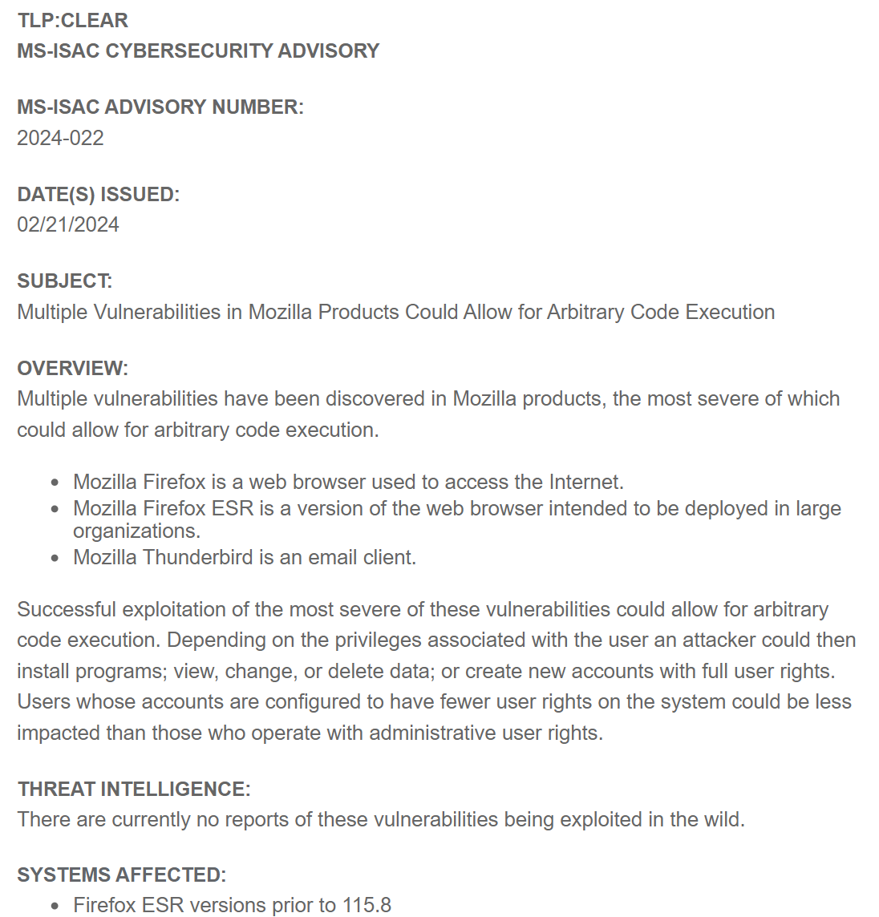
Cybersecurity Awareness 3
Browser: Malvertising and Drive-By Downloads and Exploit Kits

Slide 52
VII. Unfinished Business

Slide 53
VIII. New Business

Slide 54
IX. Adjourn

